Slide 1
Overview of Low Vision Technology
Presenter:
Janet Ledyard
Teacher/Consultant
For Blind/Low Vision
Elkhart County Special Education Cooperative

Slide 2
Topics to cover
Choosing LVT for low vision students: Factors to consider
Technology tools
  Non-optical devices
  Optical devices
  Video magnifiers
  E-book Readers
  Screen magnification technology
  Auditory tools
  Writing tools
  Cell phones - GPS

Slide 3
Objectives
Discuss factors to consider when choosing/using LVT with low vision students
Identify advantages and disadvantages of various tools
Identify resources on low vision technology

Slide 4
What can technology do?
It can provide tools for
  Accessing printed information
  Accessing electronic information
  Communicating through writing
  Producing materials in alternate formats

Slide 5
Factors to Consider:
Vision diagnosis
  Acuity measure (near & distance)
  Contrast sensitivity
  Field loss
  Visual attention/fixation
  Cortical Vision impairment
  Secondary factors such as nystagmus

Slide 6
Factors to Consider:
Age/grade
  Young students need simple/easy to use devices
  Introduce at young age if possible
  Higher tech./advanced technology is more appropriate for older students

Slide 7
Factors to Consider:
Print medium
  Textbook
  Books/Language Arts
  Handouts/test/quizzes
  Distance presentations
  Written expression
  Electronic files
  Websites

Slide 8
Factors to Consider
Support staff
Teacher for Blind/Low Vision
Special education teachers
Classroom teacher
Paraprofessional
Tech support staff
Administration

Slide 9
Factors to Consider
Student ability
Cognitive level
Fine motor skills
Independence/self determination
Behavior
Preferred learning channel

Slide 10
Factors to Consider:
Environment
Classroom
Desktop space
Electric outlets
Ergonomics
Mutliple classrooms
Storage
Student home use

Slide 11
Factors to Consider:
Money
Who’s paying for it?
Budget
Prioritize purchases
Consider reaching out to community organizations

Slide 12
ASSESSMENT
There are a variety of assessments available (see tsbvi.edu for a great listing)
Create your own customized version
Ongoing process as student progresses and print curriculum changes

Slide 13
Collaboration
If possible, educate all staff regarding student’s low vision devices.
Ongoing, as needs change
Individual student chart

Slide 14

What kind of tools?
Tools for accessing
information
  Visually
  Tactually
  Auditorally
It takes a toolbox
full of tools
to be successful
Notes:
Emphasize the importance of the “toolbox” concept. There is not one single tool that will assist people in accomplishing all the tasks required for education, employment, and personal needs. We don’t have a “Swiss army knife” yet. There are some multi-purpose tools that we’ll talk abouut later, but we don’t have any that will do everything.

Slide 15
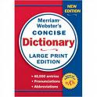

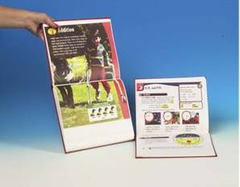



Large Print Publications
Point size: 14, 16, 18, 24
Notes:
Ask question, “What size is large print?...Is it 14 point, 16 point, 18, 24, or larger?”
(Let participants answer)
There is no law or statute in the United States that regulates or defines what size text is considered large print.
Fourteen point is larger than standard 12 point print, but most people don’t consider it large print.
The US Post Office considers 16 point large print.
The American Printing House for the Blind produces K-12 textbooks and other educational materials in 18-24 point large print.
Some books are available in LP, along with calendars, address books, dictionaries, and other publications.

Slide 16

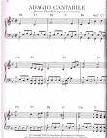
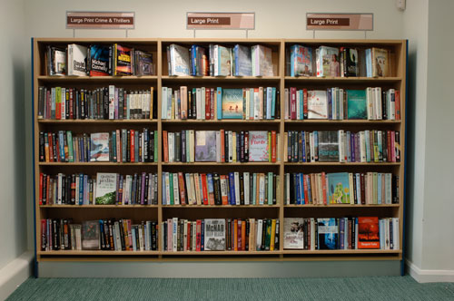


Large Print Publications
Font: Arial, Verdana, Tahoma, APHont
g g g g gggf gg
Notes:
Libraries and some book clubs are now offering titles in large print. It’s not just the point size that determines the ease of reading for people with low vision. The font selected for the text is another important variable. Surveys of readers with low vision indicate that san serif fonts are easier to read. The embellishments on serif fonts such as Times New Roman add visual clutter and are more difficult to read. Fonts without serifs, Arial, Verdana, Tahoma, and APHont are much easier to read. APHont was created by the American Printing House for the Blind based on feedback from readers with low vision who participated in the surveys. For example: the letter “g” is represented differently in different fonts. The examples shown here are Times New Roman, Arial, Verdana, Tahoma, and APHont. Fonts such as Times New Roman use a circle below the line as opposed to the traditional curved tail used by Arial and Verdana. One of the differences found in APHont is the increased space between the bottom of the circle part of the letter “g” and its descending tail. This extra space makes it more easily identified by many readers with low vision.

Slide 17
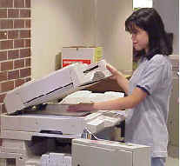
Enlarging Photo-copying Machines
Stop gap/get by method
  11 x 17 paper
    Difficult to handle
  135-150%
  enlargement
    No specific point size
  Poor quality at
  higher degrees of
  enlargement
Notes:
Enlarging text documents on a photo-copying machine should only be used when there is no other option. (Click mouse) To achieve any significant degree of enlargement you will need to use 11 x 17” paper which is difficult to handle. It doesn’t fit in notebooks, file folders, etc. It ends up being folded in half which makes it cumbersome to use. Enlargement is determined by a percentage increase so you do not know the exact point size of the text. In many cases you will need to enlarge the enlargement 2 or 3 times. As the image of the text is repeatedly enlarged the quality begins to decrease making it more difficult to see for some readers.
This type of enlargement can be used if there are no other options available, but it should never be used as the readers only option for accessing printed information. As you will see in the next few slides, there are numerous other options which will provide better access.

Slide 18
Non-optical Devices
Lighting
  Natural
    Control with blinds or shades
  Artificial
    Overhead
    Task: desk, portable, floor, other
Reading/book stand
  Desktop, portable, floor
  Copy holder
Notes:
There are many low-tech devices that can assist people with low vision. Non-optical devices are technologies that do not enlarge or magnify, but can be very helpful. (Click mouse) The benefits of good lighting is often overlooked. The availability of good lighting and the ability to control the amount of light can greatly enhance one’s ability to see and read. Both natural lighting and artificial light can be very helpful.
(Click mouse)
Book stands, or reading stands that can hold reading materials are also useful to many readers with low vision.

Slide 19
Non-optical Devices
Lighting
Importance
  Too little
  Too much
  Glare
  Direction
Source
  Natural
  Overhead
  Task
Notes:
Too little light, too much light, glare, the direction of the light, and the light source are factors that can effect one’s ability to accomplish visual tasks..

Slide 20
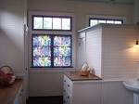

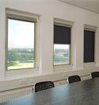
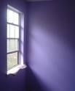

Natural Lighting
Control with
  Blinds/shades/curtains
Notes:
Natural light can be easily controlled with blinds, shades or curtains. (You might want to point out the picture on the left in which glare is caused by the light entering through the windows and how it can be controlled by the shades.) Even though we may not always be able to control the light, it is important for consumers to be aware of the effect that controlling the light can have on their ability to function efficiently.

Slide 21
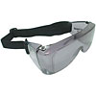
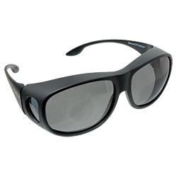



Natural Lighting
Light Filtration Systems
Noir / Solar Shield
  % Visible
    Lower % = less light
  % UV protection
  % Blue light protection
Notes:
Use the term “light filtration system” because most schools will not allow students to wear “sunglasses.”

Slide 22
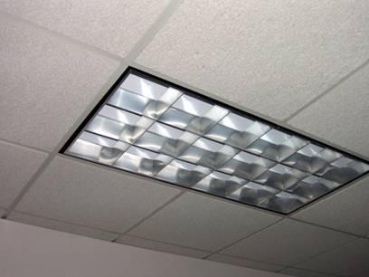
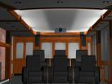
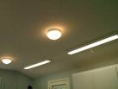
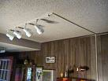
Artificial Lighting
Overhead
  Incandescent
  Fluorescent
  Halogen
Notes:
These various types are available. Users may prefer one over another.

Slide 23
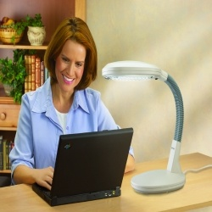
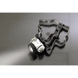
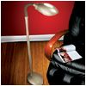
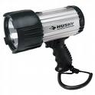

Artificial Lighting
Task lighting
  Desk/Table lamps
    Portable
    Battery powered
  Floor lamps
  Other
Notes:
Point out the advantages of having different types of task lighting to accomplish different types of tasks.

Slide 24
Task Lighting
Factors to consider
  Portability
    Size / weight
    Battery powered
    Rechargeable
    AC cord storage
  Adjustability
    Flex arm
    Gooseneck
    Clamp
  Dimmer

Slide 25

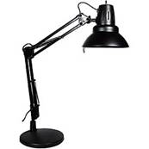
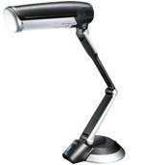
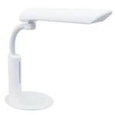
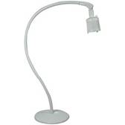
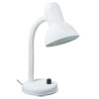
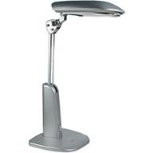
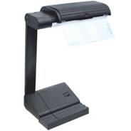
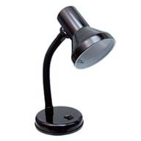
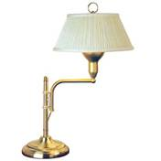
Task Lighting
Desk / table lamps
  Articulated arm
  Gooseneck
Notes:
This slide demonstrates the wide variety of styles available.

Slide 26
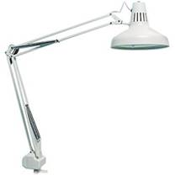
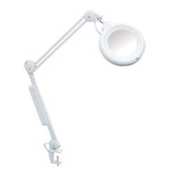
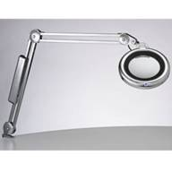
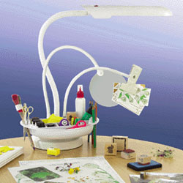
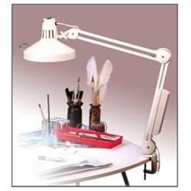
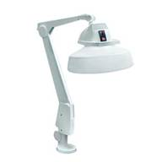
Task Lighting
Desk / table lamps
  Clamp on
  Magnifier
  Tray/clamp
Notes:
Some models that clamp onto a table or desk also have the option of a magnifier, and some even have a tray or clamp to hold the materials you might be working with. Be sure to point out that the magnifier will be low power, usually 2-3 X which may or may not be enough to complete the desired task or for reading.

Slide 27
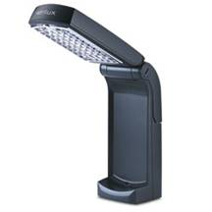
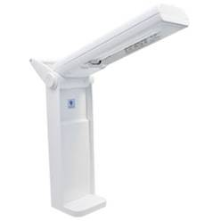
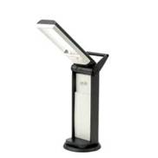
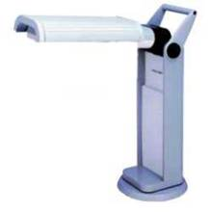
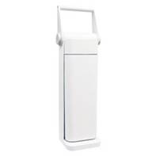
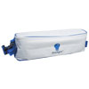
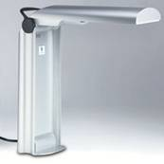
Task Lighting
Portable task lights
  AC cord storage
Notes:
This slide demonstrates the wide variety of portable lights available.

Slide 28
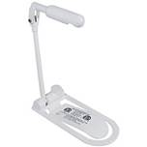
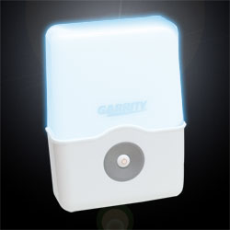
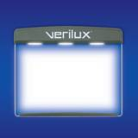
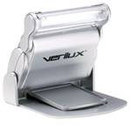

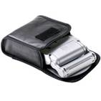
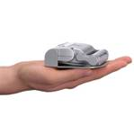
Task Lighting
Battery powered book lights
Notes:
Be careful if choosing a “book light.” Most offer a very low level of illumination

Slide 29
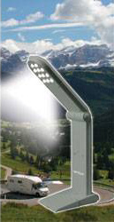
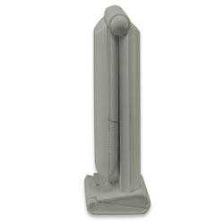
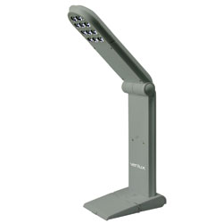
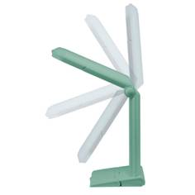
Task Lighting
Verilux Travel Lamp Natural Spectrum Rechargeable Task Lamp with 11 Bright LED Bulbs
  "Portable Light Uses A/C or Rechargeable Batteries"
Notes:
Good choice for a portable, travel light.

Slide 30




Task Lighting
Floor lamps
  Gooseneck/articulated
  Magnifier, clamp, tray
Notes:
Many models are available, some offer magnifiers, trays, or clamps. Remember, magnifiers will have low degree of magnification so it’s important to test it out with the materials the consumer will be using for reading or to complete tasks.

Slide 31






Other Lighting
Flashlights
Notes:
Hand held and head mounted for different types of tasks.

Slide 32





Non-optical Devices
Reading/Book Stands
Notes:
Book / reading stands are very useful for two reasons.
They place the reading material at a good angle for reading and reduce back and neck strain.
They allow the user to have their hands free in case they wish to use a magnifier or write.
Portable (bottom left corner), medium sized (top right & middle), and heavy duty (bottom right)

Slide 33

Non-optical Devices
Reading/Book Stands
  Lighted
Notes:
There is a model that combines both, but the illumination is not very bright.

Slide 34




Non-optical Devices
Copy Holders
Adjustable articulated arm
Notes:
These copy holders are very useful for anyone who needs to read text while typing on a computer.

Slide 35
Optical Devices
Magnifiers
  Hand-held
  Stand
  Spectacle mounted
Telescopes
  Hand-held
  Spectacle mounted
Electronic / video magnifiers
Notes:
Optical devices will need to be prescribed by a doctor as a recommendation from a low vision evaluation.

Slide 36





Optical Devices
Spectacles
Contact lens

Slide 37




Optical Devices
Hand held magnifiers
  Illuminated
  Non-illuminated
Notes:
These magnifiers are available in many different powers, different sizes, and styles. They may or may not include a built-in light source. Some are very portable like the one in the bottom right corner while others can be carried in a purse or coat pocket. Hand held magnifiers must be held the correct distance from the page in order to keep the image in focus. Some people find this difficult, especially if they have any type of motor problems such as spasticity or arthritis.

Slide 38




Optical Devices
Stand magnifiers
  Non-illuminated
    Dome – Bar
  Illuminated
Notes:
Stand magnifiers are made so that the user places the device directly on the page or material to be viewed. This ensures that the magnifier is in focus. The user doesn’t have to hold the device as steady as with the hand held magnifier. These are also available in a variety of powers, styles, and illuminated or non-illuminated.

Slide 39


Optical Devices
Clip-on
Spectacle mounted
Notes:
Some magnifiers are made to clip-on to a regular pair of glasses.

Slide 40




Optical Devices
Telescopes
  Hand-held
  Clip-on
  Spectacle mounted
Notes:
Telescopes, or monoculars, are available in a wide variety of powers and styles. Most are held in the hand but some can be clipped onto a pari of glasses or mounted right into the glasses. Again, these are devices that should be prescribed by a doctor specializing in low vision.

Slide 41
Video Magnifiers
Been around since the ’70s (CCTV)
Video Magnifier – more descriptive
Relatively easy to use
  Training will improve efficiency
  Key to training; start with high-interest materials
Basic components
  Camera
  Display
  X/Y table ???
Notes:
Video magnifiers have been around since the 1970s. They are often called CCTVs, but a more descriptive name is electronic or viceo magnifiers. These devices are relatively easy to use, but training can improve most people’s efficient use of the device.
Most video magnifiers have three basic components:
a camera with the ability to zoom in and out
a monitor or TV for the image to be displayed on, and
a platform or table to place the viewing material referred to as an X/Y table
Some of the portable units do not have an X/Y table.

Slide 42
Types of Video Magnifiers
Desktop models, $1,500 – 4,000
Flex-arm camera models,
$2,000 – 4,000
Portable models with hand held cameras, $40 – 1,000
Electronic pocket models,
$250 – 2,100
Head mounted display models,
$2,000 – 4,000
Digital imaging systems,
$2,500 – 5,500
Notes:
These devices have developed into different categories over the years. I’ll talk about each of the models in more detail in later slides.
Desktop models were the first to be introduced and they range in price from approximately $1,500 - $4,000.
Flex-arm camera models have the camera mounted on an arm in such a way that they can be rotated for both near and distance viewing. These models sell for $2,00 - $4,000.
Portable models with hand-held cameras look similar to a computer mouse, connect to a TV or monitor, and range in price $40 - $1,000.
Electronic pocket models are small battery powered units than can easily be transported and cost between $250 - $2,100.
Head mounted display models use a pair of goggles to display the image and sell for $2,000 - $4,000.
The newest models fall into the digital imaging systems category. These units combine computer chip technology with optical lens systems and cost between $1,000 – $5,000.

Slide 43

Video Magnifiers
Desktop models
Advantages
  Good for continuous text reading
  Easier for handwriting
    Working in two planes?
  Highest magnification
    Continuous zoom
  Polarity / Color
  Masks/Occluders
    Lines/Blinds
  Friction brake
  Margin stops
Notes:
Desktop models are good for longer reading tasks. When writing the user must deal with the fact that they are writing in a horizontal plane and viewing in in a vertical plane on the monitor. This can be confusing for some people at first, but most will adjust to it.
Desktop models also offer the highest degree of magnification and a continuous zoom feature for adjusting the magnification to the ideal size for the user.
These models offer reverse polarity; light text on a dark background which provides higher contrast for some users.
In addition to a full color mode they also offer a false color mode that allows the user to select the text and background colors separately.
Some models offer masks or occluders which allow the user to block off certain parts of the screen so that the magnified image only appears in a certain location on the screen. This is a good feature for users who have difficulty tracking, or staying on the desired line, while reading. The desired lne of text can be underlined or a feature similar to window shades or blinds can be adjusted so that only one line of text is visible.
Some users experience nausea or sea-sickness when reading because the line of text appears to move up and down as they move the X/Y table. Video magnifiers that have a friction brake can be adjusted so that the amount of pressure required to move the X/Y table in and out (text moves up or down) is increased thus eliminating the accidental movement.
Margin stops are a feature found on some models that assist in reading columns in newspapers and magazines. They can be adjusted so that the movement of the X/Y table is restricted to the width of the column being read.
Most models also have auto focus and manual focus. Manual focus is good for writing and handicrafts when the user wants it to stay focused on the target and not jump around to the pencil, their hands, etc.
One feature that some users find helpful is freeze frame. This feature allows the user to freeze an image on the screen and then remove the item. This can be helpful for reading directions on a box or package that has to be manipulated. Freeze frame is not available on all models so if the tasks to be completed could benefit from this the user will want to select a model that does offer freeze frame. It may be named differently by some manufacturers, but it basically does the same thing.

Slide 44



Video Magnifiers
Desktop models
Disadvantages
  Lack of portability
  Space requirement
  No distance viewing
Notes:
Desktop models are usually heavy and difficult to move from one location to another.
They generally require a good bit of desktop space because of their size and the need to move the X/Y table horizontally and vertically.
Most desktop models do not offer distance viewing features that might be needed in an educational or employment setting.

Slide 45




Video Magnifiers
Desktop / Flex-arm camera models
Near, intermediate and
  distance viewing
Acrobat LCD, Enhanced Vision
SmarView 360, HumanWare
Notes:
At times the distinction between desktop models and flex-arm camera models is not too clear. While desktop models usually have the camera mounted in the basic housing of the unit, the flex-arm camera models generally have the camera mounted on an arm or pole. The head of the camera can be rotated to different positions thus allowing near, intermediate, and distance viewing.

Slide 46



Video Magnifiers
Desktop / Flex-arm camera models
  Near-Intermediate-Distance
  SmartView
  Graduate
  HumanWare
  Aumax VG
  Aumed
  MultiView
  Optelec
Notes:
Aumed (China) makes Aumax VGA in this in-between category.(top left photo)
HumanWare makes the SmartView Graduate (bottom right photo)
The MultiView from Optelec also offer near, intermediate, and distance viewing (bottom center photo)

Slide 47



Video Magnifiers
Flex-arm camera models
Advantages
  Distance/near viewing
  Color / reverse polarity
Notes:
Video magnifiers with the camera mounted on a flexible arm offer the advantage of near and distance viewing
These models also offer many of the features found on desktop models:
full color
false color
reverse polarity
auto focus / manual focus.

Slide 48


Video Magnifiers
Flex-arm camera models
Advantages
  Some portability
Notes:
Many of the models in this category offer portability and can be easily moved from one location to another.

Slide 49



Video Magnifiers
Flex-arm camera models
Advantages
  Smaller footprint
Notes:
These models generally have a smaller footprint and take up less space on the user’s desk or work area than a desktop model.

Slide 50



Video Magnifiers
Flex-arm camera models
Disadvantages
  Set-up time
  Lack of X/Y table
  Require monitor
Notes:
The major disadvantage of any portable system is the amount of time it takes to set up the device and then pack it up when the user is ready to move to another location.
Most of these units do not include an X/Y table which may make it more difficult for users to read books and magazines.
Many flex-arm camera models do not include a monitor. Therefore the user will need to have a monitor in all the locations where they wish to use the device or connect it to a laptop computer to use the laptop’s monitor.

Slide 51



Video Magnifiers
Portable models with hand held cameras
Advantages
  Better for short reading task/spot reading
Notes:
Video magnifiers that use a hand-held camera are often one of the best tools for short reading tasks often referred to as “spot reading.” They’re great for reading a prescription bottle, directions on a package, a phone bill, or any other task of short duration.
Some of these units include a display or monitor while others connect to a TV or computer monitor.

Slide 52



Video Magnifiers
Portable models with hand held cameras
Advantages
  Lightweight / Easily transported
Notes:
The video magnifiers in this category are lightweight and easily transported. Ones that include a display monitor are usually available in a case about the size of a brief case.

Slide 53




Video Magnifiers
Portable models with hand held cameras
Advantages
  Connect to TV or computer
  Often less expensive
Notes:
One feature of many of these units that make them attractive to seniors is that they can be connected to a standard TV. This allows them to just carry the camera unit when visiting family and friends.
The other major advantage of this category of video magnifiers is their relative low cost. They range in price from approximately $40 to $1,000. The bottom center photo shows the $40 model, but it has to be connected to a computer. The other devices show here are approximately $100and can be connected to a TV. They do not offer as much magnification as models in the desktop and some other categories, but their price and convenience make them a good tool for some users.

Slide 54



Video Magnifiers
Portable models with hand held cameras
Disadvantages
  Manipulating the camera
  Some require external monitor
Notes:
Using a TV or computer monitor can be both and advantage and disadvantage of models in this category. While it may seem easy to gain access to a TV there are tasks such as reading a price tag in a store where units that do not include a monitor would not be usable.
The biggest disadvantage to models with a hand-held camera is the manipulation of the camera. That’s why these devices are better for short reading tasks as opposed to reading a book. Most users will find it fatiguing to read multiple pages of print with a device that requires you to repeatedly move the camera from left to right over the text. This is particularly difficult for individuals who have any type of motor impairments or spasticity such as a Parkinson’s patient.

Slide 55





Video Magnifiers
Portable models with hand held cameras
Disadvantage
  Difficulty handwriting
Notes:
The other major disadvantage of video magnifiers in this category is that they are not very helpful for tasks that require handwriting. People are often very attracted to these units because of their price, but caution must be taken to make sure the device will allow the user to accomplish the desired task in a manner that is comfortable and efficient.

Slide 56



Video Magnifiers
Electronic pocket models
Large
  Medium
    Small
Notes:
One of the newer categories of video magnifiers can be referred to as electronic pocket models. This category has grown so rapidly in the past few years that it can now be divided into models that are large, medium, and small. Some of the smaller units are priced around $250-400. The medium sized models are in the $450-800 price range while the larger devices may range from $1,000-2,000.
These units offer many of the features of other types of video magnifiers:
range of magnification, but not as wide as desktop models
true color / false color / reverse polarity
auto focus
freeze frame
But one of their biggest advantages is that they are battery powered and can be easily transported.

Slide 57



Video Magnifiers
Electronic pocket models
Large
  Large, angled screen
  Writing option ???
Notes:
Models that fall into the large category generally have a 5-7 inch screen that can be angled for optimum viewing. These units can be used for handwriting on a limited basis. Tasks such as filling out a check, recording information in a check book register, completing a form, or completing short answer questions on a test are possible with these devices.

Slide 58



Video Magnifiers
Electronic pocket models
Large
  Not so pocket-able
Notes:
The main disadvantage to the large electronic pocket model video magnifiers is their physical size. The are small enough to fit into a large purse or maybe the side pocket of a man’s suit, but too large for many purses or a shirt pocket. This may or may not be a big issue for some users who would be carrying the device in a backpack, book bag, or briefcase.

Slide 59

Video Magnifiers
Electronic pocket models
Medium
  Camera location
    Side / center
Notes:
Electronic pocket model video magnifiers are available in two configurations. Some models have the camera mounted on the left or right edge of the unit while others have the camera mounted in the center. Units that have the camera mounted on the side can be confusing for some users. It is natural to place the device directly over the desired viewing target just as one would with a traditional hand-held or stand magnifier. When using this approach with a model that has the camera on the side the viewer will see an image of the text or item directly under the camera lens, not what’s directly under the center of the device. The user must learn to adjust to the camera location in order to locate the desired information. Most users adjust to this fairly quickly with a bit of practice. This could be a factor or feature that might help a user when trying to decide which of the many models in this category to select.

Slide 60




Video Magnifiers
Electronic pocket models
Medium
  Fold-out handle
Notes:
Most of the medium sized electronic pocket model video magnifiers are designed to use with two hands. Several models include a fold-out handle that allows the user to hold the device in one hand and hold an object or item to be viewed in the other hand. This can be a very useful feature for reading text on a variety of items as opposed to reading a book or magazine.

Slide 61


Video Magnifiers
Electronic pocket models
Medium
  Distance viewing
Notes:
There are two models available in this category that also offer distance viewing. The FarView from Optelec and the SenseView Duo from HIMS allow the user to press a button that changes the camera lens in such a way that will allow the user to see targets in the distance. This can be very useful for viewing text on a black/white board, reading signs in a store or fast food restaurant, or for just looking at something far away, As with any device that provide a high degree of magnification these units are somewhat difficult to hold still. This is where the freeze frame feature comes in very handy. The user can freeze the image, or take a picture, and then use the zoom-in function to see the distance target. If you zoom-in first and then use freeze frame there is a very good chance that the image will be a bit blurry. However, this is not always a big problem depending on the level of detail you need to see in the image. When trying to locate the Menswear section in a discount store the user may not need to be able to clearly read every letter in the sign to identify it so an image that is somewhat blurred might still be very helpful. The only negative aspect of these devices is their price. You’ll have to pay over $1,000 to have the advantage of distance viewing in an electronic pocket model video magnifier.

Slide 62



Video Magnifiers
Electronic pocket models
Medium
  Variety of
  models
Notes:
The medium sized electronic pocket model video magnifiers are available in a wide variety of styles. Most offer a magnification range between 3X and 20X along with true & false color, reverse polarity, and freeze frame.

Slide 63




Video Magnifiers
Electronic pocket models
Medium
  Variety of models

Slide 64




Video Magnifiers
Electronic pocket models
Medium
  Variety of models

Slide 65




Video Magnifiers
Electronic pocket models
Medium
  Variety of models

Slide 66





Video Magnifiers
Electronic pocket models
Small
  Less expensive
Notes:
Small electronic pocket model video magnifiers are less expensive than other models in this category. They are truly pocket-able and easily fit into a shirt or pant pocket. These are great tools for spot reading out in the community because of their small size, built-in light, and long battery life.

Slide 67




Video Magnifiers
Electronic pocket models
Small
  Truly pocket-able
Notes:
More models are becoming available in this category.

Slide 68




Video Magnifiers
Electronic pcket models
Advantages
  Better for short reading tasks / spot reading
  Easily transported
  Less expensive
Notes:
The advantages of electronic pocket model video magnifiers are that they are less expensive than other models. They use rechargeable batteries so they are truly portable, and they are good for spot reading in a variety of locations.

Slide 69


Video Magnifiers
Electronic pocket models
Disadvantages
  Camera movement
  Difficult for handwriting
  Magnification range
    clicks – not continuous
  Book edge
Notes:
The disadvantages of devices in this category are the need to move the camera over the material to be viewed, the difficulty of trying to write using the device, and the fact that the edges of the device often catch on the edges of magazines or other reading material. One additional feature that a potential user will want to consider is that many of these devices do not offer a continuous smooth zooming ability. Most have a button that when pressed cycles through three or four different magnification levels. Some users will find this acceptable while others will prefer a model that offers a continuous zoom feature.

Slide 70






Video Magnifiers
Head mounted display models
Advantages
  Portability
  No monitor
Disadvantages
  Expense
  Appearance
Notes:
Video magnifiers that offer a head mounted display are no longer widely available as they once were. While their portability made them attractive, their expense and appearance made many potential users turn away from them.

Slide 71




Video Magnifiers
Digital imaging systems
Advantages - myReader 2
  Portability – “lugability”
  Prompter
    Column mode
  Tickertape
    Row mode
  Single word
    Word mode
myReader 2
Notes:
Video magnifiers that are categorized as digital imaging systems combine high resolution optics with basic computer technologies. Devices in this category take a digital picture of text placed under the camera and process the information to allow the user to view it in several ways. In addition to the familiar options for magnification, color, and polarity, these systems can display the text in a “word-wrap” mode similar to how a computer based word processing program displays text. This allows the user to view the text in a column similar to a prompter used by news casters and politicians without having to physically move the reading material. Others prefer to use the option that presents the text as one continuous line of text, or just one word at a time.

Slide 72

Video Magnifiers
Digital imaging systems
Disadvantages - myReader 2
  Price
  Difficulty with
  color backgrounds
  Graphics only in
  live mode
myReader2
Notes:
The expense of this model has limited its wide spread use. This unit, as do others in this category, has difficulty with text printed on colored backgrounds often found in elementary school textbooks and some magazines. One other limitation of these models is that graphical information such as maps, photographs, and drawings can only be viewed in the live camera mode. The user can switch between the live camera mode and the digitized text reading mode so many users are able to adjust to this limitation.

Slide 73


Video Magnifiers
Digital imaging systems
Advantages – Zoom-Ex
  Lightweight camera & stand
  Works with laptop
  No X/Y table needed
Zoom-Ex
Notes:
The ZoomEx systems is a lightweight camera that connects to a laptop computer for increased portability and reduced cost.

Slide 74

Video Magnifiers
Digital imaging systems
Zoom-Ex Modes
  Live camera
  Cursor key navigation
    Retains graphics
  Word wrap
    No L/R moving,
    no graphics
  Editable text
  Audio assisted reading
    Pairs synthesized speech
    with highlighted text
Zoom-Ex
Notes:
This system offers the user several different modes for accessing the printed information. There is a live camera mode that is similar to a desktop video magnifier. Where this unit differs is in its ability to allow the user to press the Arrow keys on the computer to move the view of the camera around so that the entire page can be seen without having to physically move it. This eliminates the problem of wavy line of text discussed earlier which may cause some users to feel nauseous. The third viewing option is similar to those found on the myReader 2 including the column mode and the single line mode.
The next mode uses optical character recognition (OCR) software to convert the image of the text into editable text that can be saved as a file. This file can then be opened on the computer with a word processing program and accessed with screen magnification software or screen reading software.
The last option produces a reading experience referred to as audio assisted reading or audio supported reading. In this mode, text is displayed on the screen in the user’s preferred size, font, and color combination. While viewing this text each word is highlighted in reverse video and spoken via synthesized speech producing a visual and auditory presentation of the information. Many people find this to be an excellent and efficient way of reading large quantities of text.

Slide 75

Video Magnifiers
Digital imaging systems
Zoom-Twix
  Two camera / Two pounds
  Switch between
  distance and
  near viewing
  Use with Zoom-EX
  features
Notes:
The Zoom-Twix system, also from ABIsee, Inc. adds a second camera to the system to provide distance viewing capability. A keyboard command allows the user to quickly switch between near and distance viewing as needed.

Slide 76



Video Magnifiers
Digital imaging systems
Read It Scholar
  Portable, near and distance viewing $3500
Notes:
Read It Scholar Is another model in this category that is portable and offers both near and distance viewing, It is made in England by VisionAid Technologies, and sold in the US by Magnification Resources, Inc. for approximately $3,500.

Slide 77

Video Magnifiers
Digital imaging systems
Read It Scholar (Digital Capture System)
  Scroll image for viewing
  Magnify, capture,
  read aloud and store
  Viewing modes
    Image view
    Column
    Overlay
    Horizontal/Vertical
Notes:
This system offers similar features to ZoomTwix including live camera mode, cursor-key scrolling of image, digital reformatting for ease of reading, text capture with OCR software, and highlighted text supported by synthesized speech. The text can be viewed as a column, an overlay, or in either a verticle or horizontal mode.

Slide 78

Video Magnifiers
Digital imaging systems
PEARL – FS
  Portable reading solution
  Live camera mode
  Virtual X/Y table
  Word wrap
  Uses OpenBook 9
    Speech
    Highlights spoken text
  No option for distance
Notes:
The PEARL system from Freedom Scientific is another model in this category that offers similar features, but currently does not offer a distance viewing feature. PEARL uses Freedom Scientific’s OCR program, OpenBook, to produce the speech and highlighted text. It is also a lightweight camera unit that connects to a laptop computer for portability.

Slide 79



Tools for Accessing Print/Electronic Information Visually – E-book Readers
Kindle 2 / Kindle DX / Kindle 3
  Easy ordering
  Scalable fonts / Speech
  Poor navigation
Kindle DX
Kindle 2
Kindle 3
Notes:
The Kindle e-book reader offers easy ordering of books from the Amazon Bookstore. The Kindle 2 and Kindle DX only offer speech access and the ability to adjust the size of the text once the book is open. The menus that must be used are not accessible. In the Kindle 3 model the menus can be navigated with speech. Two accessibility options still remain. The first is that some publishers will not allow their books to be accessed through the synthesized speech of the Kindle. The other major deficit involves navigating through the book when using the Kindle speech feature. If a reader wishes to hear a certain part of the text again, the only option is to return to the top of the current page and then begin reading again. This can be a very inefficient process for those students who wish to review specific passages or employees preparing for a business presentation. These limitations inhibit the widespread use of the Kindle for many people with low vision.

Slide 80



Tools for Accessing Print/Electronic Information Visually – E-book Reader
  Sony E-reader
  Barnes & Noble “nook”
  eDGe
Notes:
The Sony E-reader, the Barnes & Noble “nook”, and the eDGe all offer very limited options for users with low vision to adjust the size of the text.

Slide 81

Tools for Accessing Print/Electronic Information Visually – E-book Readers
ClassMate Reader
Notes:
The ClassMate Reader is a good option to consider for students in K-12. It can display text in a variety of font styles at up to a 20 point size. This will be adequate for some users but obviously not for all. It’s usefulness if expanded by the highlighting of text as it is spoken via synthesized speech.

Slide 82

Tools for Accessing Print/Electronic Information Visually – E-book Readers
File Compatibility:
  DAISY 2.x
  DAISY NISO
  NIMAS
  TXT, HTML, XML files
  MP3 audio format (coming soon through a downloadable update).
Notes:
The ClassMate Reader works with a wide variety of file formats including the most commonly used formats for textbooks.

Slide 83

Tools for Accessing Print/Electronic Information Visually – E-book Readers
Speech
  Words are highlighted as they are read
  Built-in text-to-speech (TTS) using the new Nuance Vocalizer human-sounding voice
  Playback through stereo headphones or built-in speaker

Slide 84

Tools for Accessing Print/Electronic Information Visually – E-book Readers
Study tools:
  Highlighting
  Text or Voice Notes
  Bookmarks

Slide 85

Tools for Accessing Print/Electronic Information Visually – E-book Readers
Speaking Dictionary:
  More than 25,000 words
  Provides
    Spelling
    Pronunciation
    Meaning

Slide 86

Tools for Accessing Print/Electronic Information Visually – E-book Readers
Voice-recording capability via built-in microphone
  Record thoughts while reading
  Use the microphone to record teacher lectures for future reference
  Great for reminders, to-do lists, and homework messages

Slide 87

Tools for Accessing Print/Electronic Information Visually – E-book Readers
Book playback:
  Internal memory
  SD card slot
  USB flash drive
Rechargeable
Lithium Ion battery
  7 hrs playtime
  4 hrs recharge
  Built-in battery charger

Slide 88

Tools for Accessing Print/Electronic Information Visually – E-book Readers
Built-in stand - for hands-free listening
Built-in speaker
Headphones jack
Color screen, 2” X 3”
Weight, 10.7 oz dimensions, 3.54” x 6.1” x 0.98”

Slide 89





Tools for Accessing Print/Electronic Information Visually – E-book Readers
E-book Readers
Apple iPad
  VoiceOver
  Zoom
  White on Black
    High contrast
Notes:
One of the best options currently available for an e-book reader for someone with low vision is the Apple iPad. This device offers a magnification program called Zoom that will enlarge the text on the screen. The system can also be set to display light text on a dark background for higher contrast if desired. If the user prefers, the speech program VoiceOver can be used to hear the text spoken. Unfortunately, at this time, these two programs can not be used simultaneously. Continued improvements in this platform will offer greater flexibility in the futuer.

Slide 90

Screen Magnification Technology
Notes:
Can’t see your computer screen adequately? No problem, just get a big pair of glasses to place in from of the screen. (Hopefully this gets a laugh!)

Slide 91



Screen Magnification Technology
Hardware Options
  Large Monitors
  Hardware Screen Magnifiers
Notes:
A larger monitor might possibly help in some cases. Larger monitors only make the text a little bit larger. They also increase the distance between the user’s eyes and the edges of the monitor. In most cases the small increase in text size is negated by the increased viewing distance so a larger monitor by itself may be of little benefit. However, a larger monitor combined with some other options may prove useful to some people with low vision.
Another tool that some people think might be useful is a magnifying lens that can be placed in front of the monitor. These types of magnifiers only provide 1.25-2X magnification. For most users with low vision this will not be enough of an increase to be satisfactory. The other problem with these magnifiers is the distortion that occurs near the edges of the screen.

Slide 92


Screen Magnification Technology
Hardware Options
  Flex-arm monitor stands
Notes:
Fully articulated flexible monitor arms can be very useful to some people with low vision, particularly when used in combination with a larger monitor or with some of the computer operating system adjustments that we will talk about in a few minutes. The big advantage of the adjustable monitor arm is that the user can raise the monitor to a comfortable (ergonomically correct) height for viewing, and then pull the monitor as close to their eyes as desired. This approach allows the user to have the monitor close while still be able to sit up straight and not have to lean toward the monitor.

Slide 93






Screen Magnification Technology
Microsoft magnifying mice
Wireless Notebook Presenter Mouse 8000
Wireless Laser Mouse 6000
Natural® Wireless Laser Mouse 6000
Wireless Laser Mouse 5000
Wireless Mobile Mouse 3000 / Special Edition
Notes:
There are several mice available from Microsoft that offer a magnify feature. They offer few other vision related features but may be just enough for some users using a combination of hardware and software options.

Slide 94
Screen Magnification Technology – Software Options
Adjustments to Windows Operating System
  Display Properties
    Settings
      Screen area (Screen Resolution)
    Appearance
      Scheme
        High Contrast Black / White (XL, Large)
        Windows Classic (XL, Large)
        Windows Standard (XL, Large)
      Item
        Icons, Menus, Tool Tips
Notes:
By making some adjustments to the way the Windows operating system displays information on the screen the user can increase the size of various screen elements such as icons, menus, and text. Using these adjustments in combination with a larger monitor mounted on an adjustable monitor arm may be adequate for some users.

Slide 95
Screen Magnification Technology – Software Options
Adjustments to Windows Operating System
  Mouse pointer
    Control Panel, Mouse, Pointer
      Scheme
        Black, Inverted, Standard (large, extra large)
  Accessibility Wizard
  Microsoft Magnifier
Mac OS
  Zoom
  Voice Over
Notes:
Another item that can be adjusted which might increase the accessibility of the computer for someone with low vision is the size and color of the mouse pointer. There is also a feature in Windows called the Accessibility Wizard that is designed to assist users in adjusting the system to make it more accessible. The user may need a sighted assistant to make these adjustments at first. If these adjustments are not adequate then the user can try the Microsoft Magnifier which is a program that enlarges text and images on the screen. It does not have as many features as the screen magnification programs we will talk about in a few minutes, but it may useful in combination with some of the hardware options discussed earlier.
Macintosh computer users can access the Zoom screen magnifier or the Voice Over screen reader to improve access on their computers.

Slide 96












Screen Magnification Technology – Software Options
Mouse Pointer Enlarging Software
  Search on the Internet for
  “big cursors”
Notes:
There are multitudes of free mouse pointer / cursors available on-line. You can search for “big cursors.”

Slide 97
Keyboarding
Keyboarding skills are essential for efficient use of the computer
They are generally quicker than using a mouse or some other pointing device
There are numerous “typing tutors” available in the general market
Many are usable with screen magnification software
Soft are specific for people with visual impairments

Slide 98
Keyboarding
In the mid 90’s reservation centers had the operator using a computer with a mouse, while the employees who were blind used keyboard only interfaces. Once the companies realized that the keyboard users were 20 percent more efficient, they cut the mouse from those applications. Of course they left the mouse for solitaire as it is slow dragging cards via a keyboard.
    Pat Fischer
      BrailleArt.com – The Art you Touch
    www.keyboardhelpers.com/timestudy.html

Slide 99
Keyboarding
TypeAbility 3.0
  For youths & adults
  Uses JFW for speech (JAWS demo)
  Magic for magnification
  $99
  www.yesaccessible.com
Notes:
This program is specifically designed for people using the screen reading program JAWS and the Magic screen magnifier.

Slide 100



Keyboarding
  Talking Typing Teacher – MarvleSoft Ent.
  Talking Typing Tutor – De Witt & Associates
  Talking Typer - APH
Notes:
These three typing tutors work with screen magnifiers and screen readers.

Slide 101







Keyboarding
  Large Print Keyboards
  Zoom Caps
  Encourage looking, not Touch Typing
Notes:
Many people think that a large print keyboard will make working on the computer easier for people with low vision. For some individuals a large print keyboard may be helpful, especially if the user is a “hunt & peck” typists. However if the individual is striving to be a “touch typist” there is a good chance that the large print on the keys will make the user spend more time looking for the correct keys and not leaning to type by touch. These large print keyboards should be avoided for students and competitive employees unless they do not intend to become touch typists.

Slide 102

Keyboarding
Keyboard Helpers
  www.keyboardhelpers.com
Keyboard shortcuts for
  The Operating System
    Window XP, Vista, Windows 7 Mac OSX
  MS Office
    Word
    Excel
    Outlook, etc.
  Internet Explorer
Notes:
Identifying and locating keyboard commands for the compute programs people are using may be a problem. The website “keyboardhelpers.com” offer a wide variety of resources listing the keyboard short-cuts for many popular program.

Slide 103
Screen Magnification Technology
Screen Magnification Software
  ShareWare and FreeWare
  Trace Windows Software Toolkit
    http://trace.wisc.edu/world/computer_access/win95/win95sha.html
  Low Vision Gateway www.lowvision.org/
  The Screen Magnifier Homepage www.magnifiers.org
  Microsoft Magnifier
  MAC OS – Zoom
Notes:
There are many free and shareware screen magnification programs available on the Internet. These can be useful for some people with low vision , but many find that these programs do not have the range of magnification and range of featuers that they need.

Slide 104


Screen Magnification Technology
Screen Magnification Software
  Lite Versions <$100
    WinZoom Lite
      Magnifier & reader, 1.5x-4x, 2 view modes, mouse enhancements
    ZoomText Express
      Up to 2x, 2 view modes, pointer and cursor enhancements
Notes:
Low cost screen magnifiers offer very basic features.
ZoomText Express offers magnification choices between 1X and 2X. For some users this will not be enough enlargement to work with their computer efficiently. Other users may find that this level of magnification in combination with some of the hardware options discussed earlier may be adequate.
WinZoom Lite magnifies from 1.5X – 4X. This program offer more features, but the higher levels of magnification make some text look jagged.
Both of these program offer a Full screen viewing mode and a lens viewing mode in addition to options for selecting the size and color of the mouse pointer/cursor.

Slide 105




Screen Magnification Technology
Screen Magnification Software
  Mid-priced Screen Magnifiers, ($400)
    Win Zoom / iZoom (USB or CD)
    Lightning /w speech
    System Access To Go
      Serotek
Notes:
These screen magnifiers offer an attractive alternative to the full featured programs for many users who primarily use their computer for browsing the Internet, e-mail, and word processing. Most of these are available on CD or on a USB flash drive that can be used on different computers in various locations.
One feature that many uses like about these programs is that they offer the ability to have text spoken via synthesized speech. Students and busy professionals find the combination of seeing the text and hearing it simultaneously a good tool for reading longer passages.

Slide 106



Screen Magnification Technology
Screen Magnification Software
  Full Featured Screen Magnifiers
    MAGic (Freedom Scientific, $500)
    SuperNova (Dolphin, $1200)
      Also includes screen reader
    ZoomText (AiSquared, $600)
Notes:
Full featured screen magnifiers offer uses more advanced features than can be found on the lower cost programs. These include custom configurations and options that can help an employee work more efficient with third party applications such as the software used by an insurance company to track their customers policies.

Slide 107






Screen Magnification Technology
Screen Magnification Software Features
  View modes
    Full
    Line
    Lens
    Area
    Horizontal split
    Vertical split
Notes:
Screen magnification software can be adjusted to allow the user to view the enlarged image in a full screen mode, or have just one line of text enlarged. Another option is the lens view which is very similar to a magnifying glass which can be moved around the screen and magnifies whatever is underneath it. An adjustable and larger version of the lens mode is referred to as the “area” mode.. Finally, some programs offer the user the ability to have the screen split into two sections either vertically or horizontally. One section displays the magnified image and the other displays the unmagnified image. Efficient users learn to use keyboard commands to quickly switch between these views depending on the nature of the material they are trying to view.

Slide 108
Screen Magnification Technology
Screen Magnification Software Features
  Magnification levels
  Foreground/background colors
  Cursor enhancements
    Mouse pointer
    Insertion cursor
  Hot spots
  Shortcut keys
  Speech support
    Reading modes
Notes:
Other features of a screen magnifier that are import include the range of magnification, the ability to control the text and background colors. While most programs allow the user to adjust the size and color of the mouse pointer, not all have features that help the user locate the insertion pointer when typing text into the computer. Some of the full featured programs offer the ability to set a “hot spot” on the screen and then have a “shortcut key” combination that can be pressed to make the view quickly jump to that location. Finally, some of the program in the mid-priced and
full featured categories also offer synthesized speech support to assist in reading text.

Slide 109
Assistive Technology Demonstration Videos
Video Magnifiers – Part 1
  Desktop and Flex-Arm Models
Video Magnifiers – Part 2
  Head Mounted Displays and Portable Models
Screen Magnification Technologies
Screen Magnification Software
  www.afb.org/at
Notes:
If you/d like to learn more about video magnifiers and screen magnification technology there are four short videos available at the American Foundation for the Blind website that will be helpful to people who are unfamiliar with these technologies.

Slide 110





Auditory Tools
Readers
Books on Tape
Digital Talking Books
Notes:
Many people with low vision at times choose to access information by listening to a recording or through synthesized speech. This can be accomplished with a live reader, an analog or digital recording, or through the use of a dedicated auditory e-book player.

Slide 111



Auditory Tools
Book Sense, GW Micro
VictorReader Stream
  HumanWare
BookPort Plus, APH
Notes:
Dedicated audio e-book readers specifically designed for people who have low vision or who are blind work with a variety of file formats making these devices very popular. Their lightweight and long lasting batteries allow them to be used in a variety of settings.

Slide 112
Auditory Tools
Scan and read systems
  Stand alone systems
  Text readers
  Software based systems
Cell phones
  Scan and read
  Bar code readers
  Paper currency identification
Accessible PDAs
Notes:
Another category of tools that are used by people with low vision are often referred to as, scan and read systems. Some of these require the use of a personal computer while others are stand-alone devices similar to an appliance. Users investigating this area of technology will want to be careful about which option they choose. While most of these tools are very helpful, some require the user to visually hightlight the desired text they wish to have read, and offer limited options for navigating through the text.
With the advent of cameras in cell phones we are now seeing applications developed that provide this ability, and some also include bar code scanning and paper currency identification.

Slide 113




Auditory Tools
Specialized Scanning Systems
  Stand alone reading machines
Notes:
Stand alone reading systems were first introduced in the late ’70s but were very large and extremely expensive. These units are now about the size of a sheet of 8 ½ x 11 inch paper and are simple enough for very young children to use.

Slide 114


Auditory / Visual Tools
Specialized Scanning Systems
  Stand alone reading machines
  Eye-Pal Solo
Notes:
Several companies have developed systems that can be used not only have the text read aloud, but with the additionj ofa monitor the use can also see the text in their preferred size, font, and color combination.

Slide 115

Auditory / Visual Tools
Specialized Scanning Systems
  EVAS – Scan, Read & Magnify
Notes:
The scan, read & magnify system form EVAS is another model in this category that strives \to make operation of the system very simple for users who have little or no experience with high tech devices.

Slide 116


Auditory / Visual Tools
Intel Reader
  Converts printed text to digital text
  Camera
  OCR
  Speech
Notes:
The Intel Reader is a tool designed for students with reading difficulties, but can also be used by individuals with low vision to access printed information. The unit can be place in its stand, or held over the item to be read. The built in camera takes a picture of the text which is then converted with the optical character recognition software. The converted text is then read aloud by the unit’s speech synthesizer. Many students are finding this tool to be very helpful in school.

Slide 117





Auditory Tools
Text Readers
  Read Please
  Natural Reader
  Universal Reader
Notes:
Text readers are software programs that run on computers. Most of these programs require the user to highlight the text they wish to have read aloud by the speech synthesizer. These programs generally have very limited ability to allow the user to easily navigate through the text.

Slide 118

Multipurpose
Auditory / Visual Tools
Dolphin GUIDE Software Suite w/LP & Speech Access
  20 useful programs
  Easy to use / easy to learn
  Built-in screen reader
  Built-in screen magnifier
  $795
Notes:
The Guide Software Suite from the Dolphin company in the United Kingdom takes the approach of combining many of the tools that one might need to use into one package. This program allows the user to access the information visually or through synthesized speech.

Slide 119



Multipurpose
Auditory / Visual Tools
Guide’s Easy-To-Use, Customizable Menus
Notes:
One of its big advantages is that all of its options are accessed through a consistent menu system. The user selects items by either pressing a number on the keyboard or by pressing the Enter key when they hear their desired choice spoken.

Slide 120


Multipurpose
Auditory / Visual Tools
Guide’s Easy-To-Use Applications
  Address Book
  Calendar
  Calculator
  CD & MP3 Player
  Create CD & DVD
  DVD Video Player
  File Manager
  Finance Manager
  Instant Messenger
Notes:
Its other big attraction of the Guide program for many users is the variety of applications it offers including …..

Slide 121

Multipurpose
Auditory / Visual Tools
Guide’s Easy-To-Use Applications
  Keyboard Practice
  Listen to Internet Radio
  Listen to Podcasts
  Magnify Handwriting,
  Diagrams & Pictures
  Photocopier
  Record & Play
  Voice Memos
  RSS News Reader
Notes:
It also offers …

Slide 122

Multipurpose
Auditory / Visual Tools
Guide’s Easy-To-Use Applications
  Scan & Read Books & Documents
  Send & Receive Email
  Skype Internet Phone
  Spell Check,
  Dictionary & Thesaurus
  Surf the Internet
  Write Letters &
  Documents
Notes:
“But wait, there’s more.” It allows the user to …

Slide 123


Multipurpose
Auditory / Visual Tools
GUIDE Handsfree
  Voice recognition – Dragon Naturally Speaking
Notes:
The system can even be configured in such as way that the user can speak commands to the system to tell it what the user would like to do.

Slide 124



Auditory Tools
Specialized Scanning Systems
  Kurzweil
  Text Cloner Pro
  OpenBook
Notes:
There is specialized scan and reading software specifically designed for people who are blind or have low vision. Programs like Kurzweil and OpenBook allow the user to control both the visual and auditory presentation of the desired information. While these programs are rather expensive, approximately $1,000, many users feel that they provide access to information that the user may not otherwise be able to access.

Slide 125





Auditory / Visual Tools
Talking Calculators
LP Calculator
Notes:
There are many different models of accessible calculators from which consumers can choose. MaxiAids, Independent Living Aids, LS&S Group, and other offer both large print displays and talking calculators.

Slide 126




Auditory Tools
Talking Money Identifier
Talking Dictionaries
    Language Master Talking Dictionary Model LM6000SE
Notes:
Portable talking money identifiers have decreased in cost over the years to approximately $100.
Taking dictionaries have not become so affordable. There is a children’s talking dictionary form Franklin for approximately $50 but it only goes to about third grade level.
The fully accessible Language Master talking dictionary from Franklin sells for approximately $450. It speaks each letter as a word is typed intot he device, the whole word, and the definition of the word. This is the most useful talking dictionary for middle school, high school, and college students. Many adults also find this to be a valuable tool because of its dictionary, thesaurus, and grammar guide.

Slide 127




Auditory Tools
Accessible Personal Digital Assistants (PDAs)
  Non-visual
Notes:
Accessible personal digital assistants specifically designed for people who are blind or have low vision do nto generally offer a visual display, but rather provide information in an auditory format or with a refreshable braille display. These tools can be used to read a wide variety of files. Newer models even allow the user to browse the Internet, send and receive e-mail, and in some cases act as a GPS system for traveling.

Slide 128




Writing Tools
Handwriting Tools
  Bold & raised line paper
  Bold markers
  Writing guides
Notes:
People with low vision often find it difficult to produce hand written text that is easily read by themselves and by others. Low tech tools such as bold or raised lined paper used with a bold marker can be very helpful to these individuals. Those who have specific writing tasks benefit from a writing guide specifically designed for that task.

Slide 129


Writing Tools
Electronic Tools
  Dedicated word processors
  Accessible computer with word processor
Notes:
Some people may prefer to use one of the dedicated word processors such as the Neo or Dana from Alphasmart a useful writing tool. For those who will need to write lengthy documents the best writing tool will be an accessible computer with word processing software. Common features found in most word processing programs can greatly increase the writer’s efficiency and accuracy.

Slide 130

Accessible Cell Phones
Screen readers
  Mobile speaks (Code Factory)
  Talks (Nuance)
Screen magnification
  Mobile magnifier (Code Factory)
  Zoom (Nuance)
iPhone
  Voice Over - jesters
  E-book reader app
  Magnifying Glass app from I-Beam
    Poor quality, lighting, jittery
Notes:
Cell phones can be made accessible to people with low vision through the use of screen magnification software or screen reading software loaded onto the phone. There are two major companies providing these programs, Code Factory and Nuance. Because of the small size of cell phone screens, many users find the screen magnification software to be inadequate and choose to use the speech provided by the screen reading programs.
Some cell phone manufacturers are beginning to provide magnification and speech access as part of the standard features offered on their phones. Apple has led the way with Zoom and VoiceOver for their iPhones. This is an exciting development in technology. Applications that allow the user to read e-books, turn the phone into a small video magnifier, and provide GPS options are becoming common. Some users are finding that voice commands for their phones allow them to use features that might otherwise be in accessible.

Slide 131

Cell Phones
Jitterbug J
  Waived 5 minute Operator Assistance fee for anyone who is legally blind through Jitterbug’s Visually Impaired Discount program
  Speakerphone
  Big, raised, concave buttons with large numbers
  Backlit for easy dialing
  Voice dialing
Notes:
The Jitterbug is a cell phone that was specifically designed for seniors and others who might have difficulty placing and receiving calls on a standard cell phone. It does not offer any of the options found on smart phones, but it does serve as a good tool for just making basic phone calls.

Slide 132



GPS Systems
Trekker, Trekker Breeze
StreetTalk 2.0 GPS for PacMate
Sense Nav
Mobile Geo
BrailleNote GPS
Notes:
There are GPS systems specifically designed for people who are blind or have low vision. These devices only provide auditory or braille output. None have attempted to make an accessible system that uses a visual display. It may be that some of the accessible smart phones will provide such a feature. There are dedicated units like the Trekker Breeze and then others that use software loaded onto an accessible personal digital assistant.

Slide 133

Training Resources on Low Vision Technology
For additional information go to
www.afb.org/at

